Slide 1
E-Commerce Dashboard Project
Shaili Likhar

Slide 2



About Me
Shaili Likhar
Rising Senior at Rutgers University -New Brunswick, NJ
Major & Minor: Computer Science, Cognitive Science
Interests: Data Engineering, Data Analytics, and Cloud Architecture

Slide 3
E-Commerce Dataset
The excel spreadsheet gives the data of all items purchased with order details.
The products sold fall under 4 categories and are sold in 13 different regions.
The data displays the sum of the sales per month and the profits correlated with the sales.
The data also displays sum of sales based on region and product category.
The data displays the sales accumulated based on product category.

Slide 4
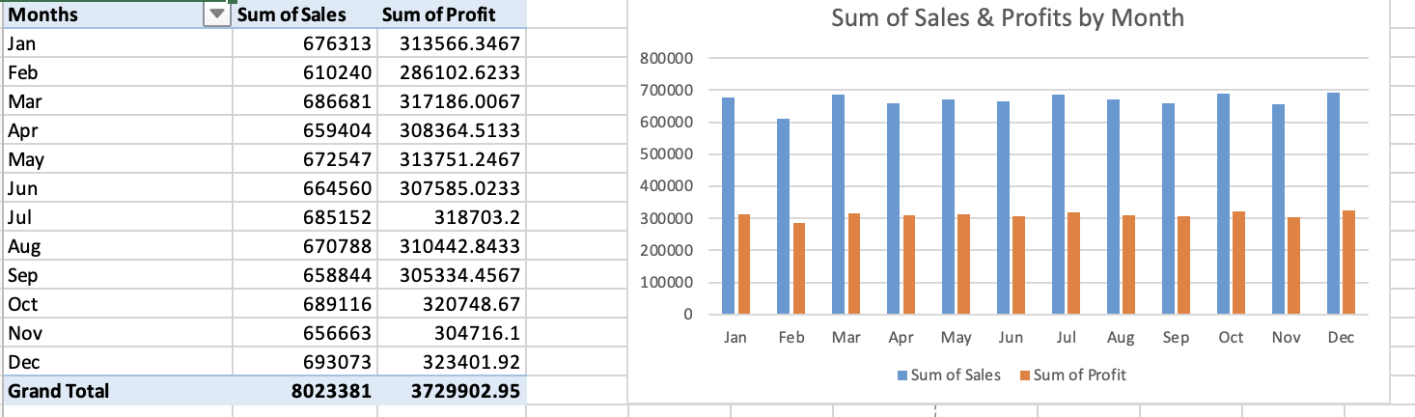
Sum of Sales & Profits by Month

Slide 5
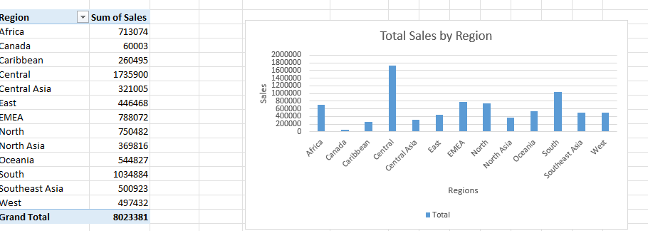
Total Sales by Region

Slide 6
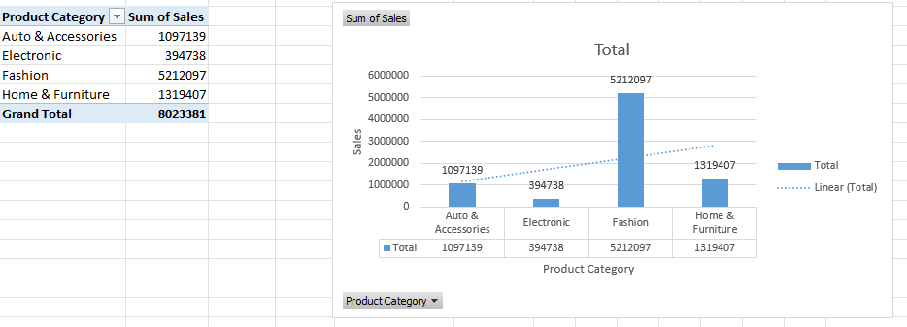
Sales by Product Category

Slide 7
Key Insights
In the month of December, the highest amount of sales and profits were made
In the month of February, the lowest amount of sales and profits were made
Over the course of the year $8,023,381 sales were made and profited $3,729,902.95
The region that had the most sales was Central with $1,735,900
The region with the least sales was Canada with $60,003
The product category with the most sales was fashion with $5,212,097

Slide 8
Conclusion
This data tells us the regions in which we should continue catering to (Central), which kinds of products we should sell more of (Fashion) and how it will increase profits.
The data analysis also shows where we should improve sales (Canada) in and which products need to be improved on/marketed better to increase sales (Electronics).

